Slide 1
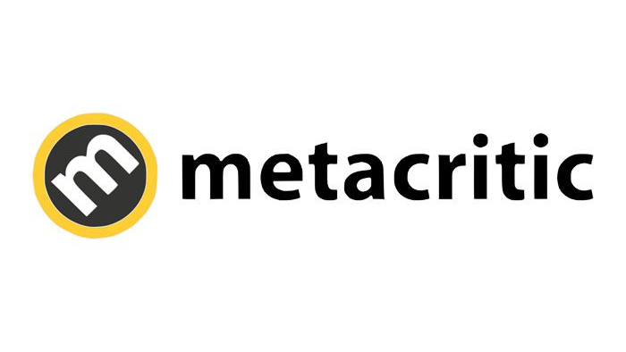
Critic Review Analysis
Hanxiao(Mia) Zhang

Slide 2
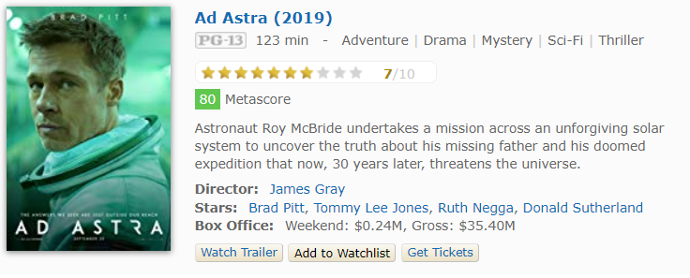
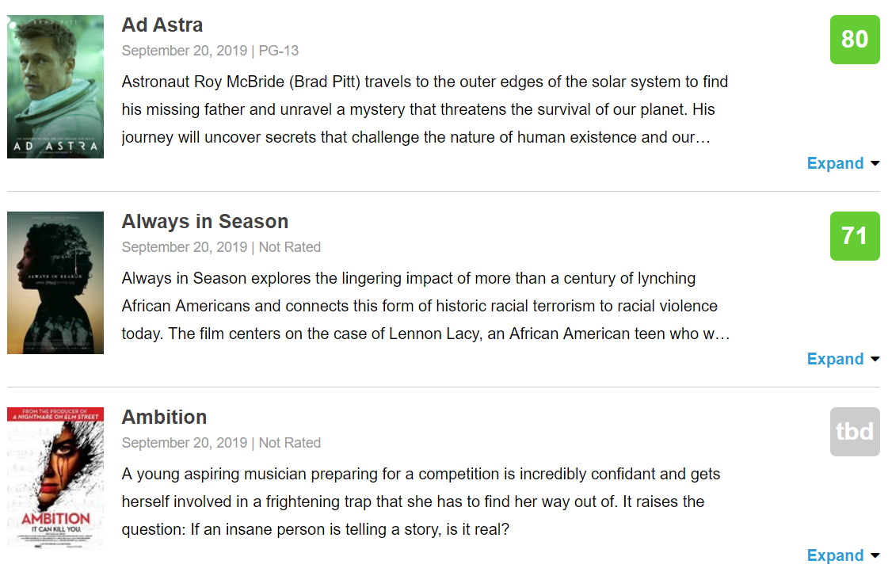
IMDb
About Metacritic
Launched in January 2001, Metacritic has evolved over the last decade to distill critics' voices into a single Metascore, a weighted average of the most respected critics writing reviews online and in print.
Metacritic

Slide 3
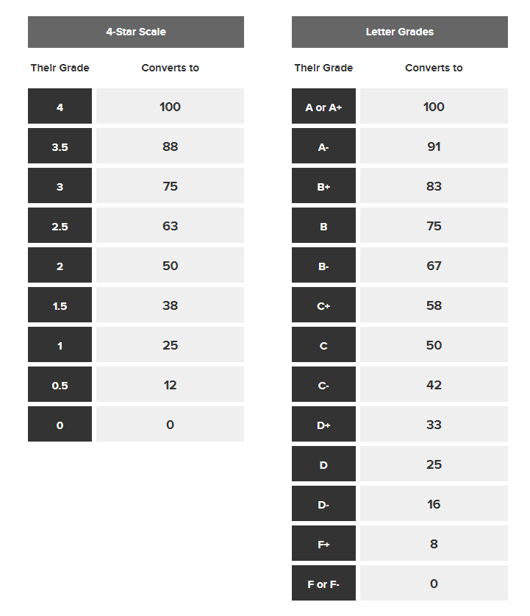
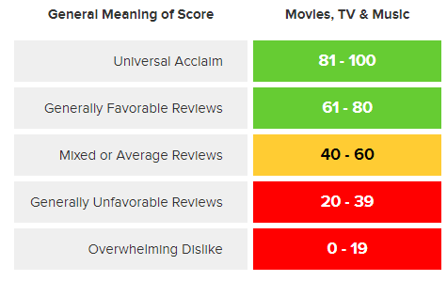
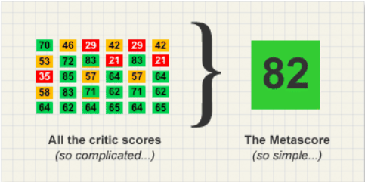
How To Create A Metascore

Slide 4




JOKER
Todd Phillips' controversial Joker origin story won Venice. Is an Oscar nomination next?
PARASITE
Bong Joon-ho's savagely funny Cannes winner could be 2019's best film.

Slide 5
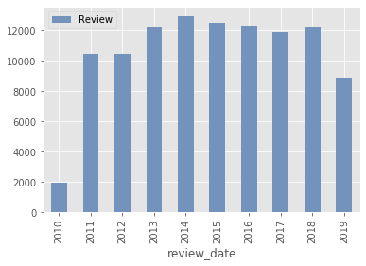
Metacritic Annual Reviews
Data Summary
247,009 Reviews & Scores
Once Upon a Time in Hollywood – 61 Reviews
12,635 Movies
25 Genres, 1,244 Distributors
3,069 Critics
Roger Ebert from Chicago Sun-Times wrote 4,753 reviews
273 Media Outlets
Multiple reviews from the same media is possible

Slide 6
Word Cloud
Sentiment Analysis

Slide 7
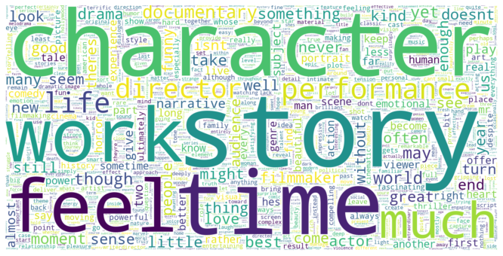
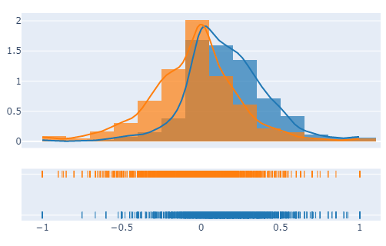
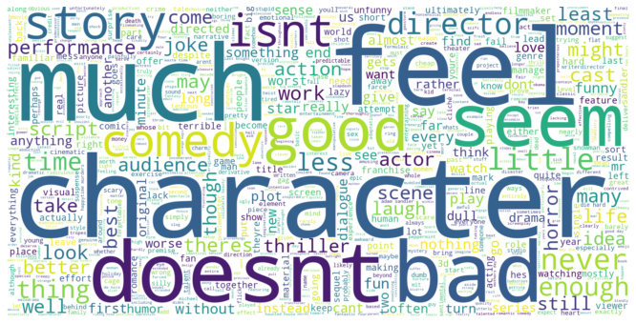

>70
Review Sentiment Analysis
<30

Slide 8
>70

Slide 9
<30

Slide 10
Factor1 Genre
Metascore VS Userscore

Slide 11
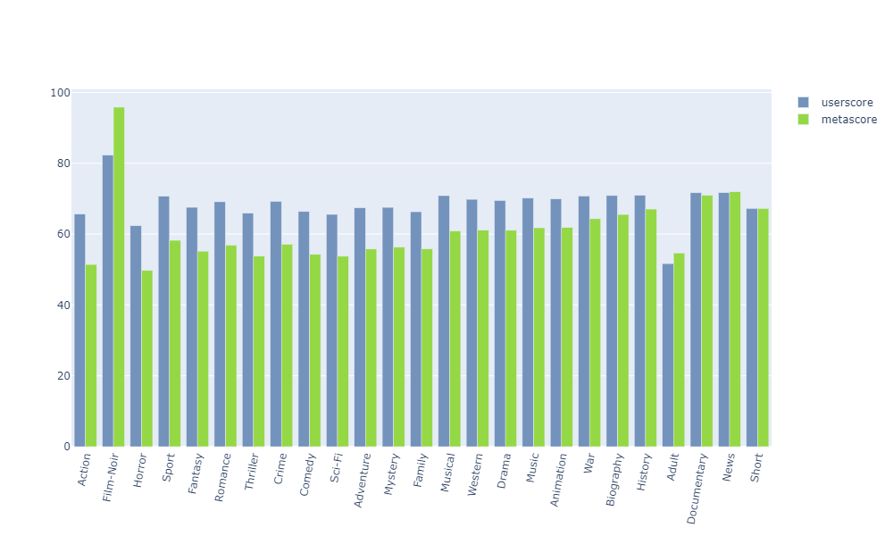
Critic & User Genre Preference

Slide 12
Factor2 Number of Reviews
For Each Critic

Slide 13
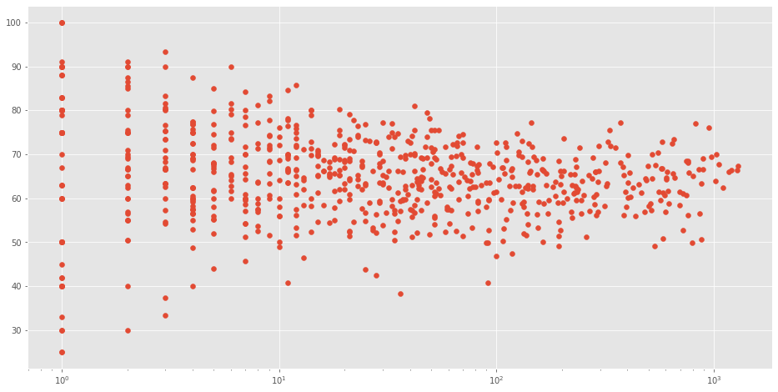
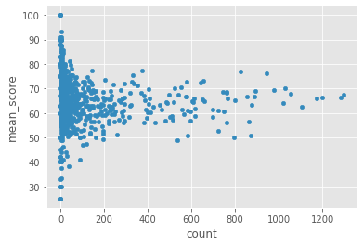
Average Score VS Number of Reviews

Slide 14
Factor3 Review Published Date

Slide 15
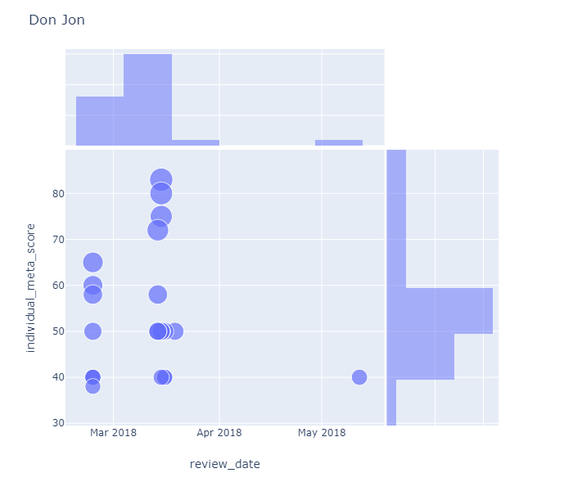
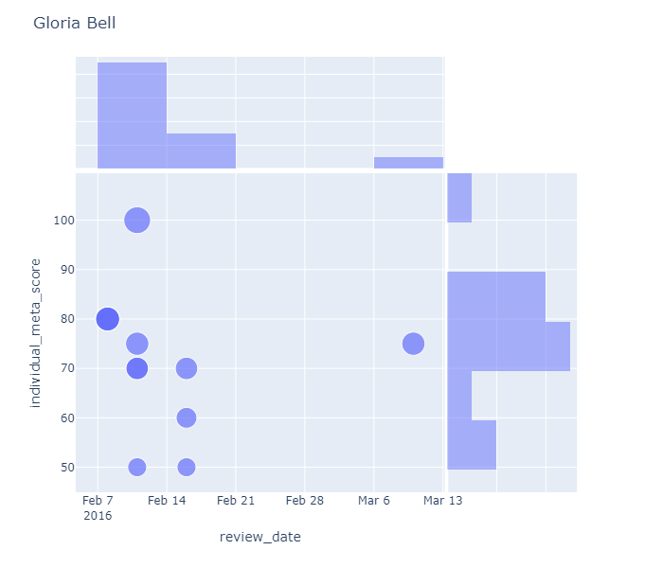
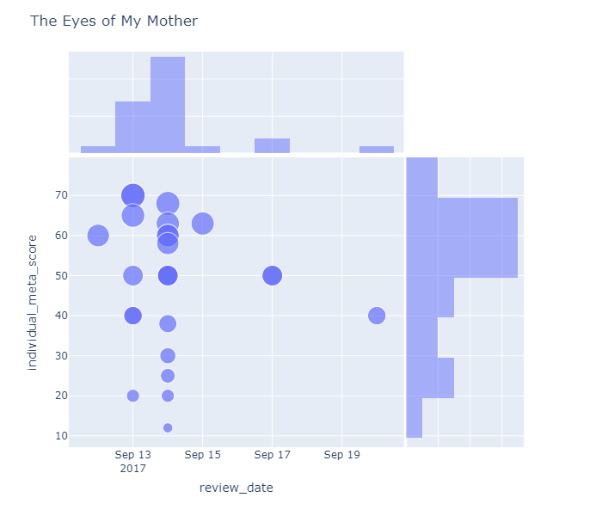
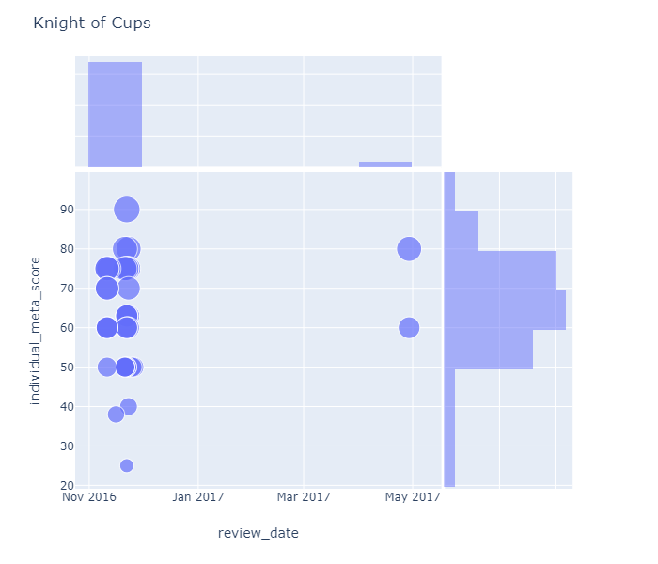
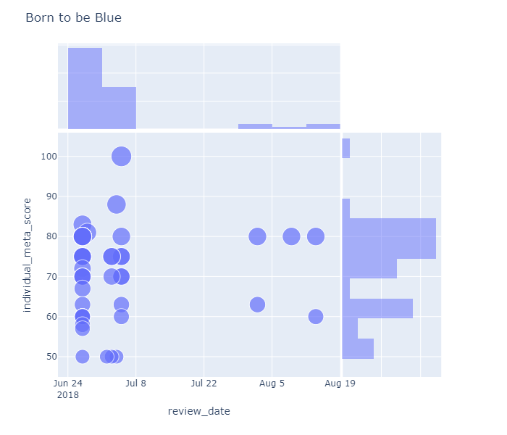
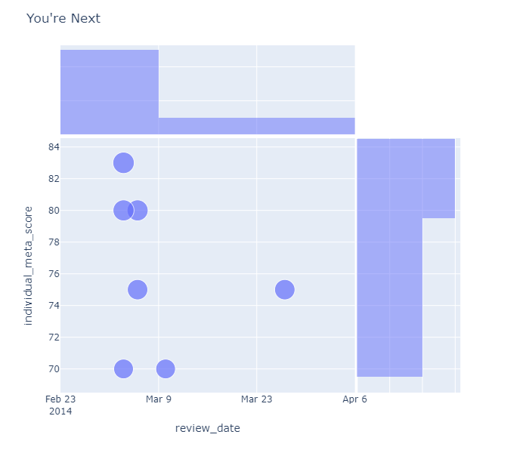

Slide 18
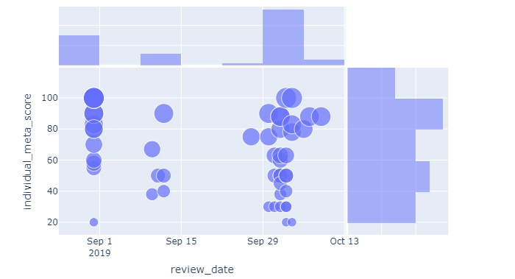
Joker Review Published Date Analysis
Venice Movie Festival
Movie Release
Metascore 59
The New York Times 30
The New Yorker 30
The New Yorker 20
The WSJ 20
Time 20
Critic Screening

Slide 19
Genre Preferences
Review Publish Date
Critics prefer documentary, drama, history to horror, action movies
Higher scores are given pre movie release
Number of Reviews
Metacritic’s Choice
Critics with less reviews tend to have higher average scores or positive reviews
Choose respected critics
Assign scores to reviews
Apply weighted average

Slide 20
THANK YOU
Q & A

